Slide 1

A Presentation on “Fault Detection in Fabrics(Woven & Non-Woven) Using Convolutional Neural Networks” By Ajinkya Bhamre Yash Uday Randive Under the Guidance of Prof. Prashant Udawant
Department of Information Technology
MPSTME, Shirpur Campus
2019-20

Slide 2
Outline
Introduction
Objective
Literature Survey
Problem Statement
Proposed Solution
Gantt Chart
UML Approach
Use case Diagram
Activity Diagram
Data Flow Diagram
Architectural Diagram
Sequence Diagram
State Chart Diagram
Result Analysis / Implementation
Testing
Conclusion
Future Work
References

Slide 3
Introduction
Manual detection of faults in fabrics has only about 60% accuracy
This means 40% of times fabrics tend to be rejected by customers due to faults and inconsistencies in the manufactured product
This results in massive financial losses to textile manufacturers

Slide 4
Objective
To develop a system that identifies and classifies fabrics(whether faulty or not) from images provided to it in order to improve the accuracy of the said process thereby helping reduce financial and material losses incurred by textile manufacturers in the manual fabric fault detection process.

Slide 5
Literature Survey

Slide 6
Research Papers | Author | Findings
[1]Adaboost learning for fabric defect detection based on HOG and SVM | - Ding Shumin, Liu Zhoufeng, Li Chunlei | Adaboost algorithm and Support vector machine is used to classify fabric defects.
[2]Fabric defect detecting and rank scoring based on fisher’s criterion discrimination | SHENG-WANG LI, LI-WEI GUO, CHUN-HUA LI | The fisher standard is utilized to delegate filtered units to its class which helps for fabric estimation by using America four point framework.
[3]Fabric defects segmentation approach based on texture primitive | - SHUANG-WU ZHU , HONG-YANG HAO , PENG-YANG LI , MEI-HONG SHI , HUA QI. | Texture primitive is used to automate fabric inspection, And automatic threshold segmentation is done by Ostu’s approach.
[4]Sparse Dictionary Reconstruction For Textile Defect Detection | -Jian Zhou,Dimitri Semenovich,Arcot Sowmya and Jun Wang. | Fabric defects are detected using Sparse representation and dictionary learning. For future work improvising this algorithm can result more efficiency.
[5]Fabric Defect Detection Based on Biological Vision Modeling | -CHUNLEI LI , GUANGSHUAI GAO1, ZHOUFENG LIU1 , MIAO YU , AND DI HUANG | The imperfection detection detected by natural vision demonstrating and low-position portrayal with a recreation of organic vision.

Slide 7
Research Papers | Author | Findings
[6] Auto encoder-Based Fabric Defect Detection with Cross-Patch Similarity | -Hu Tian, Fei Li Fujitsu Research & Development Center | The Auto-encoder with Cross patch similarity is proposed for fabric defect detection. so output of defected patch is decoded by latent variable of non defective patch.
[7]Fabric Defect Detection Based on Pattern Template Correction | Xingzhi Chang , Chengxi Gu , Jiuzhen Liang , and Xin Xu | It is amendment of imperfection detection techniques. To decrease misalignment impacts.
[8]Fabric Fault Detection Using Digital Image Processing | Farida S.Nadaf, NayanaP.Kamble, RohiniB.Gadekar Under The Guidance of: P.S.Kadu | Defected fabrics are detected using MATLAB programming and Image processing.
[9]Automated Fabric Defect Detection | Prasanna Bandara, Thilan Bandara, Tharaka Ranatunga, Vibodha Vimarshana, Sulochana Sooriyaarachchi and Chathura De Silva | Image handling and neural systems are used. A non uniform brightening and picture denoising is a preprocessing step to actual method.
[10]Implementation of Fabric Fault Detection System Using Image Processing | Sunil L. Bangare, N. B. Dhawas, V. S. Taware, S. K. Dighe, P. S. Bagmare Assistant Professor, Department of Information Technology, Sinhgad | The video feed is captured for image segmentation, RGB to HSV conversion, and by comparison faulty percentage are found.

Slide 8
Problem Statement
Manual process of fault detection in fabrics has an accuracy of 60% which incurs great financial losses to textile manufacturers thereby affecting sales and material wastes; Hence, an automation to the aforementioned problem is required in order to increase its efficiency and accuracy.

Slide 9
Proposed Solution
Using a CMOS Camera in a textile production unit to record faulty and correct textile patterns to create a fabric dataset that trains our machine learning model
Implementing Convolutional Neural Networks using python to automate the aforementioned process

Slide 10
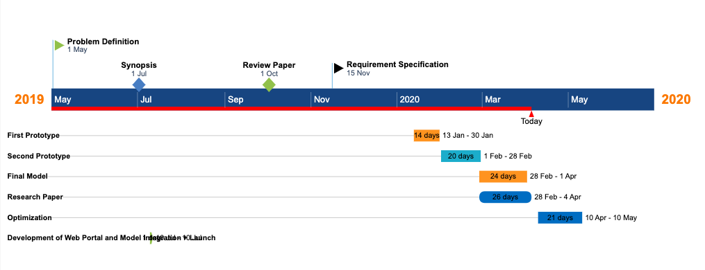
GANTT CHART

Slide 11
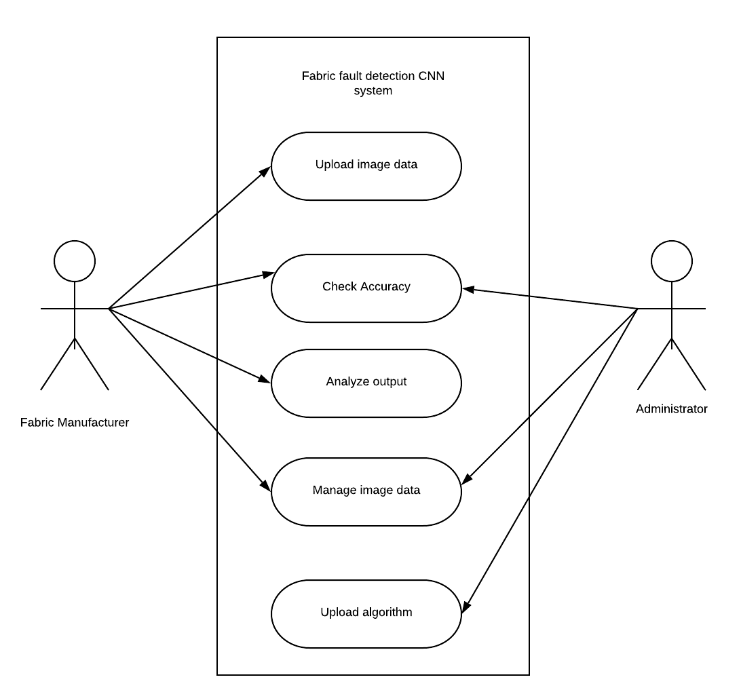
Use Case Diagram

Slide 12
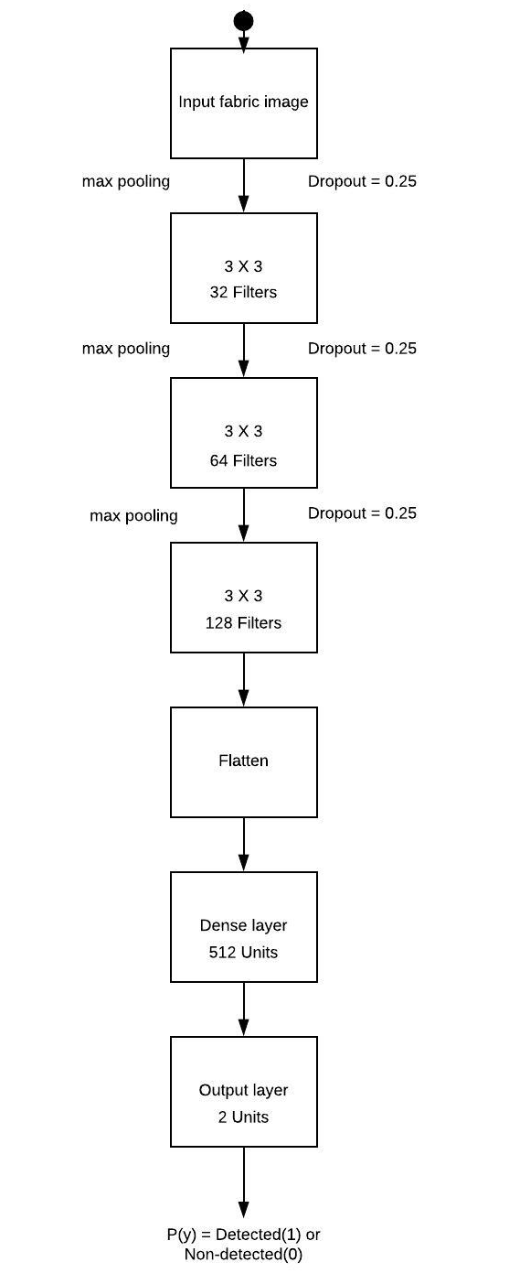
Activity Diagram

Slide 13
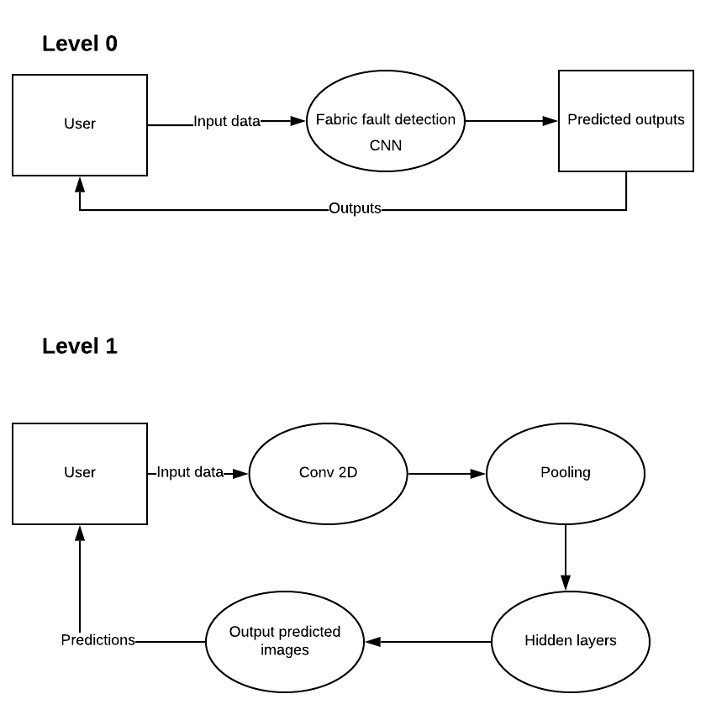
Data Flow Diagram

Slide 14
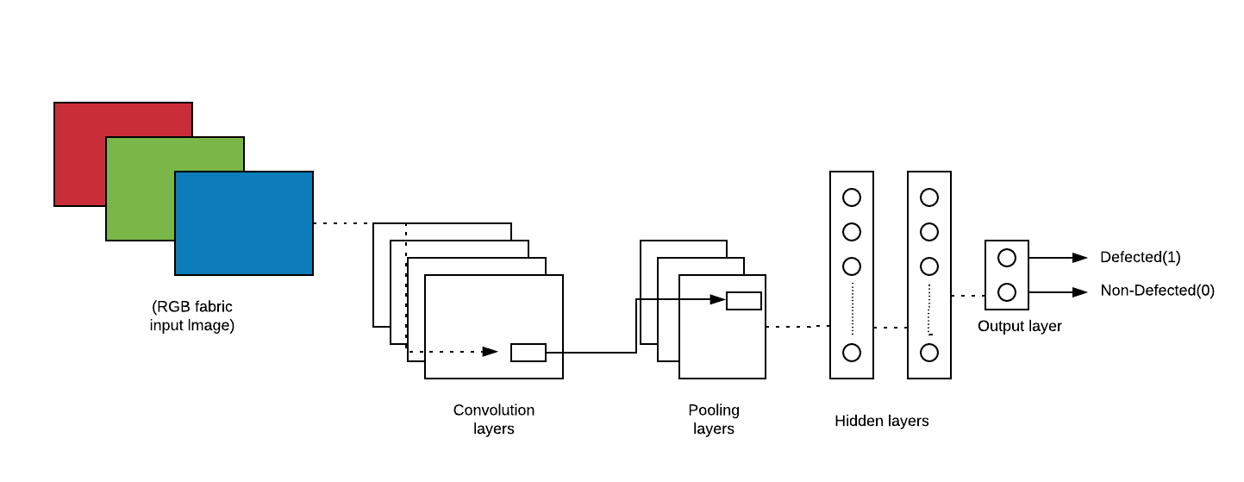
Architectural Diagram

Slide 15
Result Analysis / Implementation

Slide 16
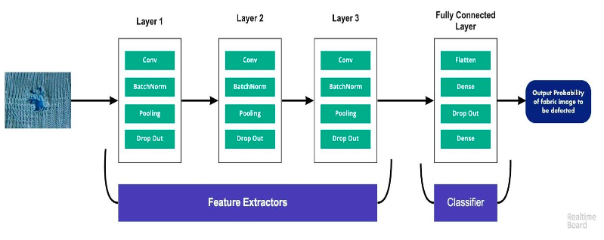
Result Analysis/ Implementation
Overview of the CNN

Slide 17
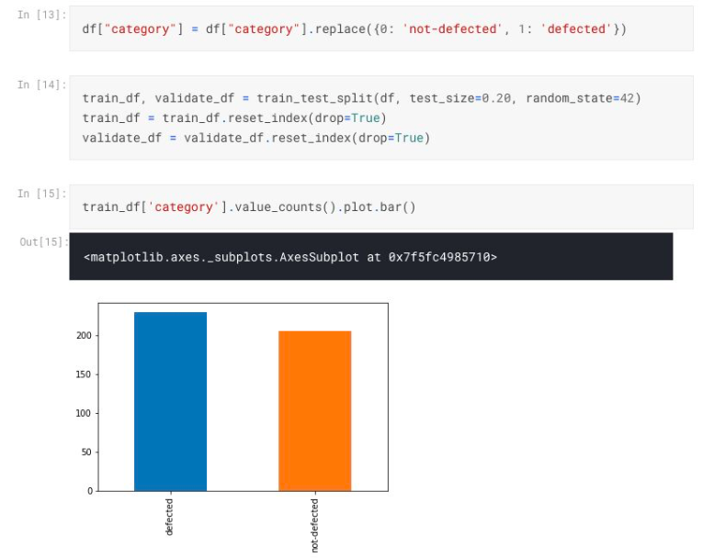
Result Analysis/ Implementation
EDA

Slide 18
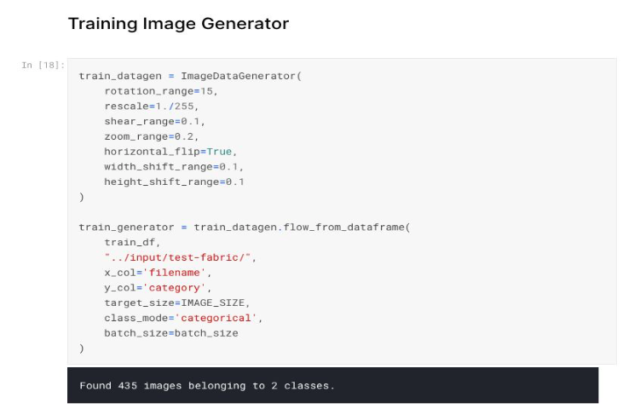
Result Analysis/ Implementation
ImageDataGenerator Class

Slide 19
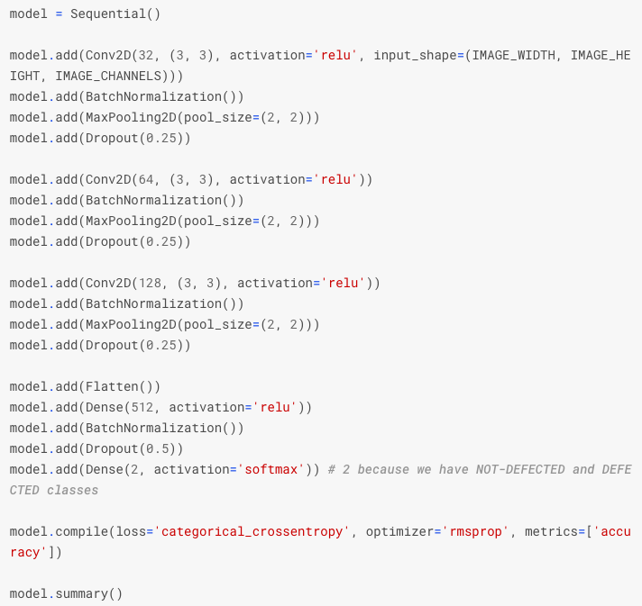
Result Analysis/ Implementation
The Model

Slide 20
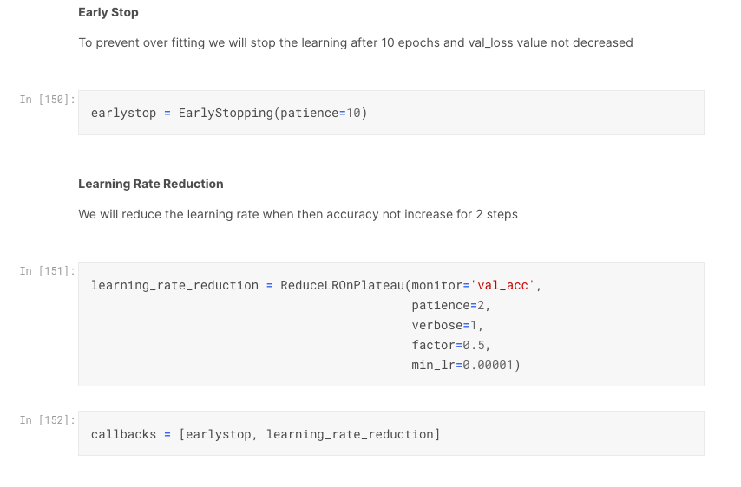
Result Analysis/ Implementation
EarlyStopping to prevent Overfitting

Slide 21
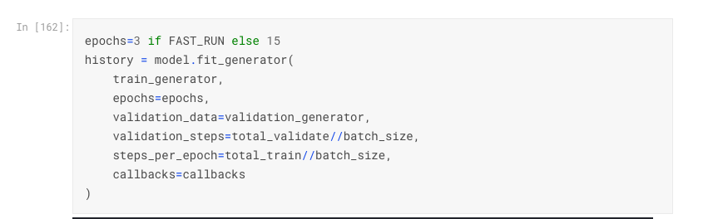
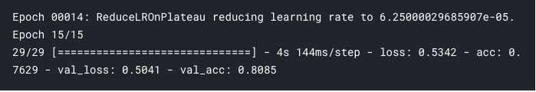
Result Analysis/ Implementation
Fitting the Data to the Model
training loss| training accuracy | validation loss | validation accuracy | Optimal Learning Rate

Slide 22
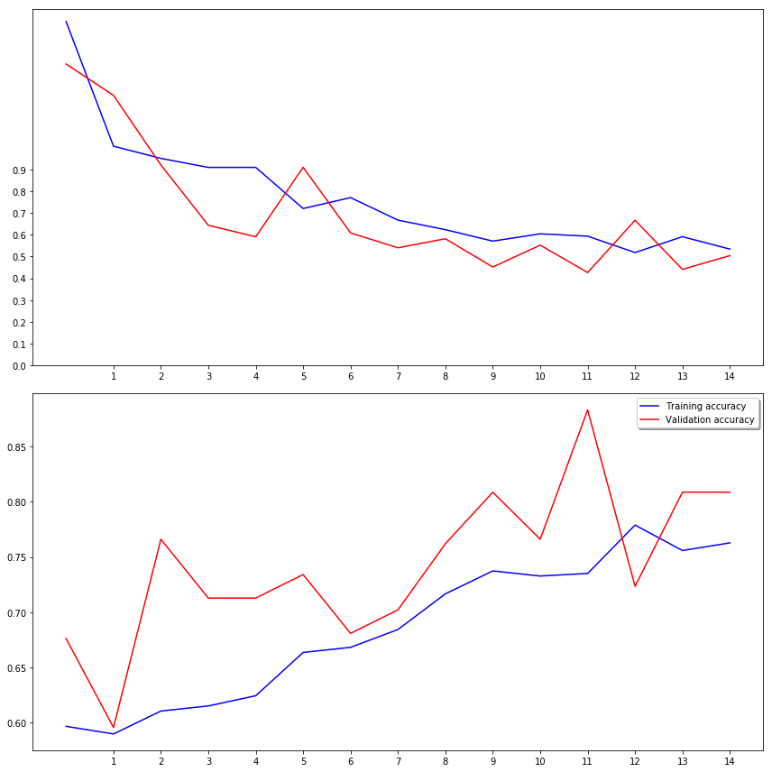
Result Analysis/ Implementation
Training Loss v/s Validation Loss
x = L(t), y = ∆L
Training Accuracy v/s Validation Accuracy
x = acc(t), y = acc

Slide 23
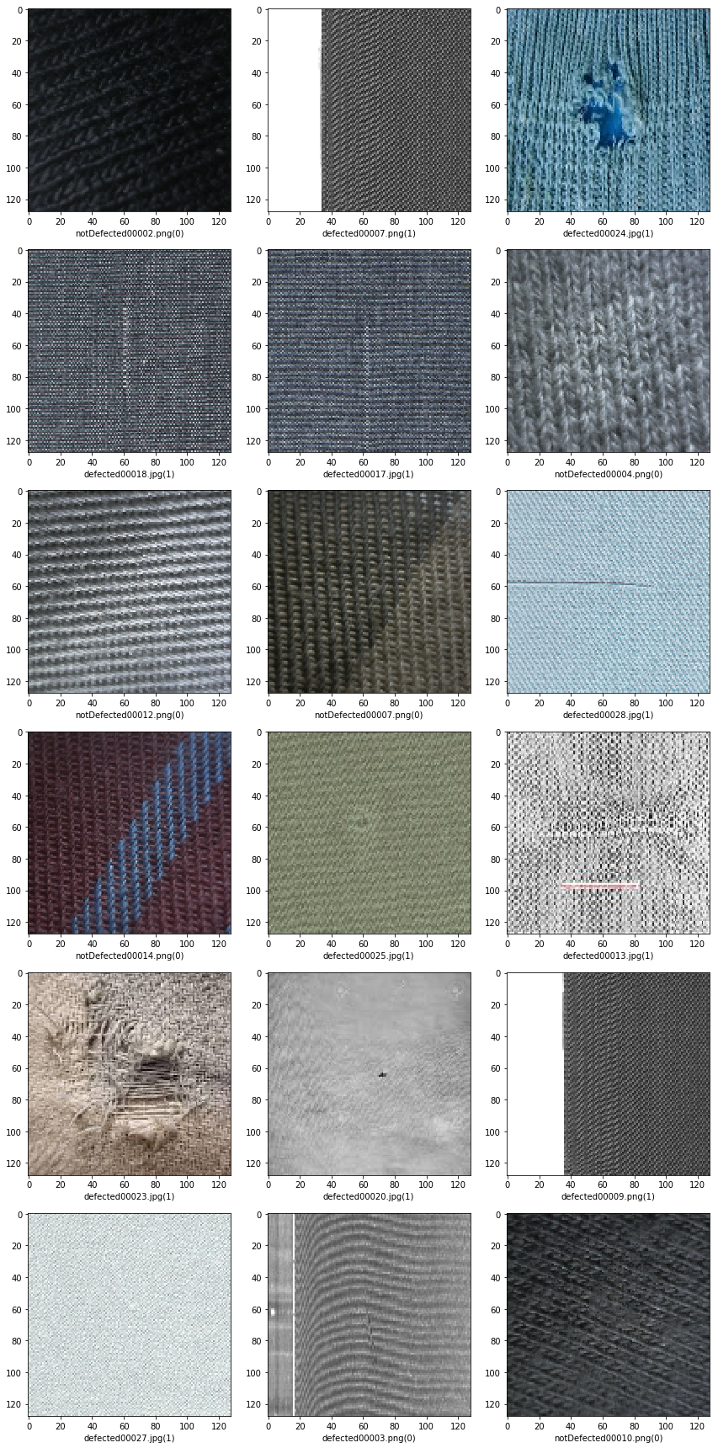
Testing

Slide 24
Conclusion
We have successfully developed a Convolutional Neural Network for the purpose of identifying and classifying fabric images into Defective & Non- Defective images with an accuracy of ≈81%. Furthermore, we have also compiled a dataset of over defective fabric images that can be expanded further to give way to more degrees of classification as well as increase the accuracy/optimize the model.
In addition to this, we have achieved an accuracy ≈21% more than that of traditional, manual methods of fault detection in fabrics and are at a position to optimize the model further and integrate it with relevant hardware and software components in order to carry out our first proof-of-concept in the market.

Slide 25
Future Work
Dataset can be expanded in order to make way for more degrees of classification in fabric faults
The model can be integrated in a web-based portal connected to a CMOS camera at manufacturing units to detect faults in fabrics in real time
The model can be optimized to show the exact position of the faults in the fabric image and generate a relevant report about the faults
Once all the aforementioned changes are made, the model can be licensed to successful businesses in the textile industry.

Slide 26
References
[1] Adaboost learning for fabric defect detection based on HOG and SVM- Ding
Shumin, Liu Zhoufeng, Li Chunlei School of Electric & Information Engineering,
Zhongyuan University of Technology Zhengzhou, China
[2] Fabric defect detecting and rank scoring based on fisher’s criterion discrimination-
SHENG-WANG LI, LI-WEI GUO, CHUN-HUA LI College of Information Science and
Technology, Hebei University of Science and Technology, Shijiazhuang 050018, China
[3] Fabric defects segmentation approach based on texture primitive- SHUANG-WU
ZHU , HONG-YANG HAO , PENG-YANG LI , MEI-HONG SHI , HUA QI. College of
Electronic Information, Northwestern Polytechnical University, xi’an 710072,China .
College of Textile and material，Xi’an Polytechnic University , xi’an 710048,China;
[4]Sparse Dictionary Reconstruction For Textile Defect Detection-Jian Zhou,Dimitri
Semenovich,Arcot Sowmya and Jun Wang. College of Textiles, Donghua University,
Shanghai, China
[5] Fabric Defect Detection Based on Biological Vision Modeling -CHUNLEI LI 1 ,
GUANGSHUAI GAO1,2, ZHOUFENG LIU1 , MIAO YU 1 , AND DI HUANG 2
1School of Electronic and Information Engineering, Zhongyuan University of
Technology, Zhengzhou 450007, China 2School of Computer Science and Engineering,
Beihang University, Beijing 100191, China

Slide 27
References
[6] Auto encoder-Based Fabric Defect Detection with Cross-Patch Similarity-Hu Tian,
Fei Li Fujitsu Research & Development Center Co., Ltd., Beijing, China
[7]Fabric Defect Detection Based on Pattern Template Correction-Xingzhi Chang ,
Chengxi Gu , Jiuzhen Liang , and Xin Xu
[8]Fabric Fault Detection Using Digital Image Processing-Farida S.Nadaf,
NayanaP.Kamble, RohiniB.Gadekar Under The Guidance of: P.S.Kadu Department of
Electronic and telecommunication Fabtech Technical Campus, College of Engineering
and Research,Sangola, India
[9]Automated Fabric Defect Detection-Prasanna Bandara, Thilan Bandara, Tharaka
Ranatunga, Vibodha Vimarshana, Sulochana Sooriyaarachchi and Chathura De Silva
Department of Computer Science and Engineering University of Moratuwa, Sri Lanka.
[10]Implementation of Fabric Fault Detection System Using Image Processing-Sunil L.
Bangare, N. B. Dhawas, V. S. Taware, S. K. Dighe, P. S. Bagmare Assistant Professor,
Department of Information Technology, Sinhgad Academy of Engineering, Pune &
Research Scholar, Department of Computer Science & Engineering, K. L. University,
Guntur (A.P.), India Department of Information Technology, Sinhgad Academy of
Engineering, Pune, India,

